Slide 1


Using Web Services
Chapter 13
Python for Everybody
www.py4e.com
Notes:
Note from Chuck. If you are using these materials, you can remove the UM logo and replace it with your own, but please retain the CC-BY logo on the first page as well as the acknowledgement page(s) at the end.

Slide 2
Data on the Web
With the HTTP Request/Response well understood and well supported, there was a natural move toward exchanging data between programs using these protocols
We needed to come up with an agreed way to represent data going between applications and across networks
There are two commonly used formats: XML and JSON

Slide 3


Sending Data Across the “Net”
PHP
Array
JavaScript
Object
{
"name" : "Chuck",
"phone" : "303-4456"
}
Python
Dictionary
Java
HashMap
a.k.a. “Wire Protocol” - What we send on the “wire”

Slide 4

Agreeing on a “Wire Format”
<person>
<name>
Chuck
</name>
<phone>
303 4456
</phone>
</person>
De-Serialize
Python
Dictionary
Java
HashMap
Serialize
XML

Slide 5
Agreeing on a “Wire Format”
{
"name" : "Chuck",
"phone" : "303-4456"
}
De-Serialize
Python
Dictionary
Java
HashMap
Serialize
JSON

Slide 6
XML
Marking up data to send across the network...
http://en.wikipedia.org/wiki/XML

Slide 7
XML “Elements” (or Nodes)
<people>
<person>
<name>Chuck</name>
<phone>303 4456</phone>
</person>
<person>
<name>Noah</name>
<phone>622 7421</phone>
</person>
</people>
Simple Element
Complex Element

Slide 8
eXtensible Markup Language
Primary purpose is to help information systems share structured data
It started as a simplified subset of the Standard Generalized Markup Language (SGML), and is designed to be relatively human-legible
http://en.wikipedia.org/wiki/XML

Slide 9
XML Basics
Start Tag
End Tag
Text Content
Attribute
Self Closing Tag
<person>
<name>Chuck</name>
<phone type="intl">
+1 734 303 4456
</phone>
<email hide="yes" />
</person>

Slide 10
White Space
<person>
<name>Chuck</name>
<phone type="intl">
+1 734 303 4456
</phone>
<email hide="yes" />
</person>
Line ends do not matter. White space is generally discarded on text elements. We indent only to be readable.
<person>
<name>Chuck</name>
<phone type="intl">+1 734 303 4456</phone>
<email hide="yes" />
</person>

Slide 11
XML Terminology
Tags indicate the beginning and ending of elements
Attributes - Keyword/value pairs on the opening tag of XML
Serialize / De-Serialize - Convert data in one program into a common format that can be stored and/or transmitted between systems in a programming language-independent manner
http://en.wikipedia.org/wiki/Serialization

Slide 12
XML as a Tree
a
<a>
<b>X</b>
<c>
<d>Y</d>
<e>Z</e>
</c>
</a>
b
c
X
d
e
Elements
Text
Y
Z

Slide 13
XML Text and Attributes
a
<a>
<b w="5">X</b>
<c>
<d>Y</d>
<e>Z</e>
</c>
</a>
b
c
w
attrib
text
node
5
X
d
e
Elements
Text
Y
Z

Slide 14
XML as Paths
a
<a>
<b>X</b>
<c>
<d>Y</d>
<e>Z</e>
</c>
</a>
b
c
/a/b X
/a/c/d Y
/a/c/e Z
X
d
e
Y
Z
Elements
Text

Slide 15
XML Schema
Describing a “contract” as to what is acceptable XML
http://en.wikipedia.org/wiki/Xml_schema
http://en.wikibooks.org/wiki/XML_Schema

Slide 16
XML Schema
Description of the legal format of an XML document
Expressed in terms of constraints on the structure and content of documents
Often used to specify a “contract” between systems - “My system will only accept XML that conforms to this particular Schema.”
If a particular piece of XML meets the specification of the Schema - it is said to “validate”
http://en.wikipedia.org/wiki/Xml_schema

Slide 17

XML Validation
XML Document
Validator
XML Schema Contract

Slide 18
XML Validation
XML Document
<person>
<lastname>Severance</lastname>
<age>17</age>
<dateborn>2001-04-17</dateborn>
</person>
Validator
XML Schema Contract
<xs:complexType name=”person”>
<xs:sequence>
<xs:element name="lastname" type="xs:string"/>
<xs:element name="age" type="xs:integer"/>
<xs:element name="dateborn" type="xs:date"/>
</xs:sequence>
</xs:complexType>

Slide 19
Many XML Schema Languages
Document Type Definition (DTD)
- http://en.wikipedia.org/wiki/Document_Type_Definition
Standard Generalized Markup Language (ISO 8879:1986 SGML)
- http://en.wikipedia.org/wiki/SGML
XML Schema from W3C - (XSD)
- http://en.wikipedia.org/wiki/XML_Schema_(W3C)
http://en.wikipedia.org/wiki/Xml_schema

Slide 20
XSD XML Schema (W3C spec)
We will focus on the World Wide Web Consortium (W3C) version
It is often called “W3C Schema” because “Schema” is considered generic
More commonly it is called XSD because the file names end in .xsd
http://www.w3.org/XML/Schema
http://en.wikipedia.org/wiki/XML_Schema_(W3C)

Slide 21
XSD Structure
<person>
<lastname>Severance</lastname>
<age>17</age>
<dateborn>2001-04-17</dateborn>
</person>
xs:element
xs:sequence
xs:complexType
<xs:complexType name=”person”>
<xs:sequence>
<xs:element name="lastname" type="xs:string"/>
<xs:element name="age" type="xs:integer"/>
<xs:element name="dateborn" type="xs:date"/>
</xs:sequence>
</xs:complexType>

Slide 22
XSD Constraints
<xs:element name="person">
<xs:complexType>
<xs:sequence>
<xs:element name="full_name" type="xs:string"
minOccurs="1" maxOccurs="1" />
<xs:element name="child_name" type="xs:string"
minOccurs="0" maxOccurs="10" />
</xs:sequence>
</xs:complexType>
</xs:element>
<person>
<full_name>Tove Refsnes</full_name>
<child_name>Hege</child_name>
<child_name>Stale</child_name>
<child_name>Jim</child_name>
<child_name>Borge</child_name>
</person>
http://www.w3schools.com/Schema/schema_complex_indicators.asp

Slide 23
XSD Data Types
<xs:element name="customer" type="xs:string"/>
<xs:element name="start" type="xs:date"/>
<xs:element name="startdate" type="xs:dateTime"/>
<xs:element name="prize" type="xs:decimal"/>
<xs:element name="weeks" type="xs:integer"/>
<customer>John Smith</customer>
<start>2002-09-24</start>
<startdate>2002-05-30T09:30:10Z</startdate>
<prize>999.50</prize>
<weeks>30</weeks>
It is common to represent time in UTC/GMT, given that servers are often scattered around the world
http://www.w3schools.com/Schema/schema_dtypes_numeric.asp

Slide 24
ISO 8601 Date/Time Format
2002-05-30T09:30:10Z
Year-month-day
Time of day
Timezone - typically specified in UTC / GMT rather than local time zone
http://en.wikipedia.org/wiki/ISO_8601
http://en.wikipedia.org/wiki/Coordinated_Universal_Time

Slide 25
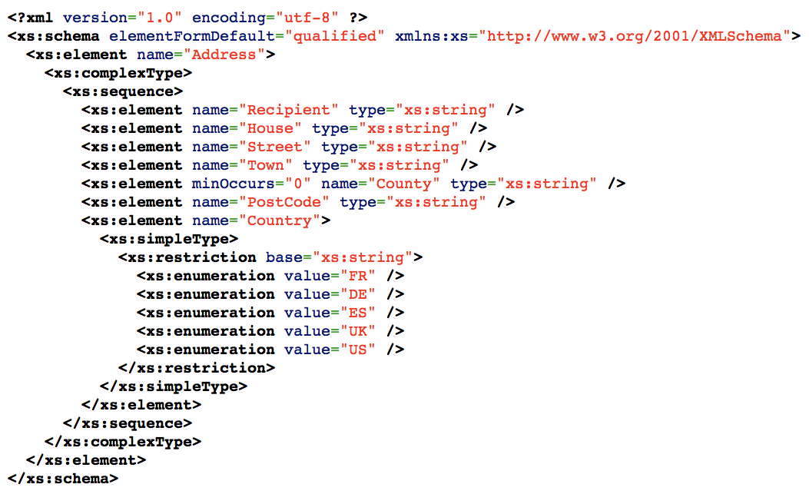
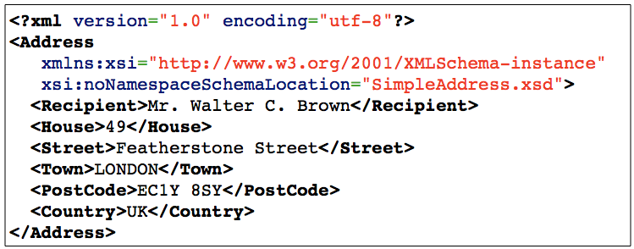

Slide 26
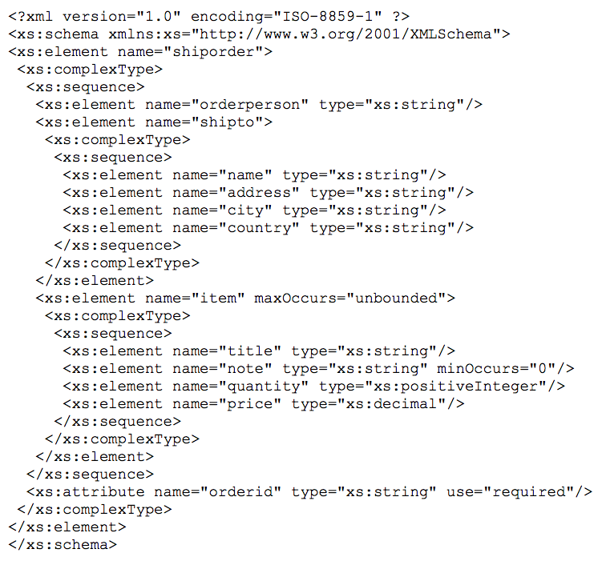
http://www.w3schools.com/Schema/schema_example.asp

Slide 27
import xml.etree.ElementTree as ET
data = '''<person>
<name>Chuck</name>
<phone type="intl">
+1 734 303 4456
</phone>
<email hide="yes"/>
</person>'''
tree = ET.fromstring(data)
print('Name:',tree.find('name').text)
print('Attr:',tree.find('email').get('hide'))
xml1.py

Slide 28
import xml.etree.ElementTree as ET
input = '''<stuff>
<users>
<user x="2">
<id>001</id>
<name>Chuck</name>
</user>
<user x="7">
<id>009</id>
<name>Brent</name>
</user>
</users>
</stuff>'''
stuff = ET.fromstring(input)
lst = stuff.findall('users/user')
print('User count:', len(lst))
for item in lst:
print('Name', item.find('name').text)
print('Id', item.find('id').text)
print('Attribute', item.get("x"))
xml2.py

Slide 29
JavaScript Object Notation

Slide 30
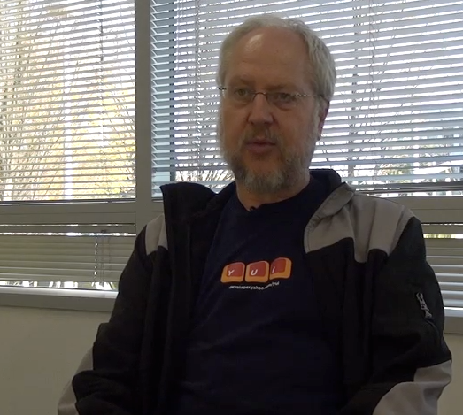
JavaScript Object Notation
Douglas Crockford - “Discovered” JSON
Object literal notation in JavaScript
http://www.youtube.com/watch?v=kc8BAR7SHJI

Slide 31
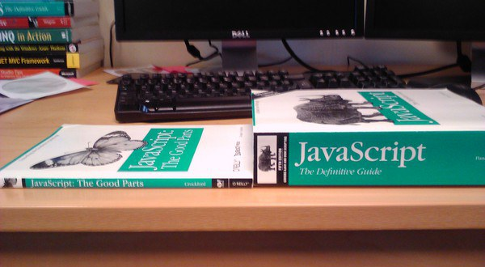

Slide 32
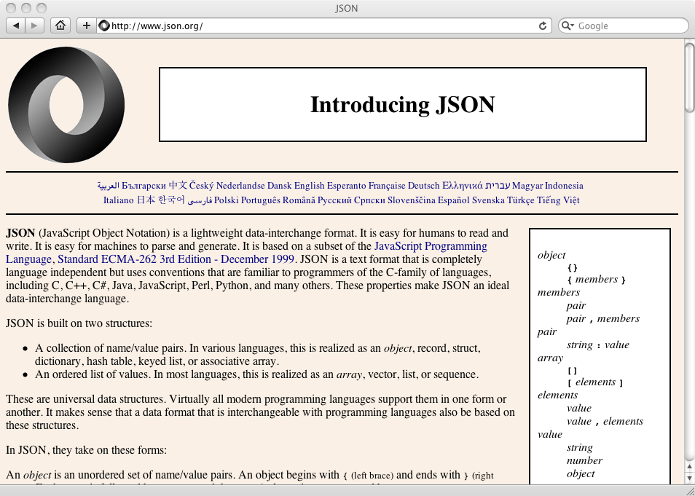

Slide 33
import json
data = '''{
"name" : "Chuck",
"phone" : {
"type" : "intl",
"number" : "+1 734 303 4456"
},
"email" : {
"hide" : "yes"
}
}'''
info = json.loads(data)
print('Name:',info["name"])
print('Hide:',info["email"]["hide"])
json1.py
JSON represents data as nested “lists” and “dictionaries”

Slide 34
import json
input = '''[
{ "id" : "001",
"x" : "2",
"name" : "Chuck"
} ,
{ "id" : "009",
"x" : "7",
"name" : "Chuck"
}
]'''
info = json.loads(input)
print('User count:', len(info))
for item in info:
print('Name', item['name'])
print('Id', item['id'])
print('Attribute', item['x'])
json2.py
JSON represents data as nested “lists” and “dictionaries”

Slide 35
Service Oriented Approach
http://en.wikipedia.org/wiki/Service-oriented_architecture

Slide 36

Service Oriented Approach
Most non-trivial web applications use services
They use services from other applications
- Credit Card Charge
- Hotel Reservation systems
Services publish the “rules” applications must follow to make use of the service (API)
Application
APIs
Service
Service

Slide 37
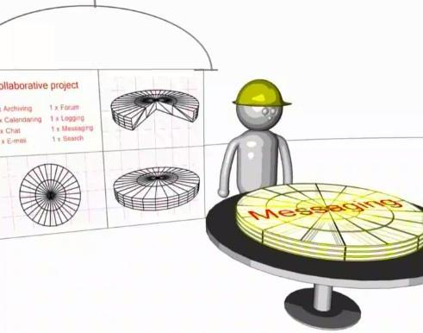
Multiple Systems
Initially - two systems cooperate and split the problem
As the data/service becomes useful - multiple applications want to use the information / application
http://www.youtube.com/watch?v=mj-kCFzF0ME
5:15

Slide 38
APIs
http://en.wikipedia.org/wiki/Web_services

Slide 39
There Are Many APIs
There are organizations that put up public APIs and sell access to those APIs
We will explore a geocoding API based on the OpenStreetMap data
You need an account to access this API
There is a free level of requests over time
You pay above that rate of usage

Slide 40

https://www.geoapify.com/

Slide 41
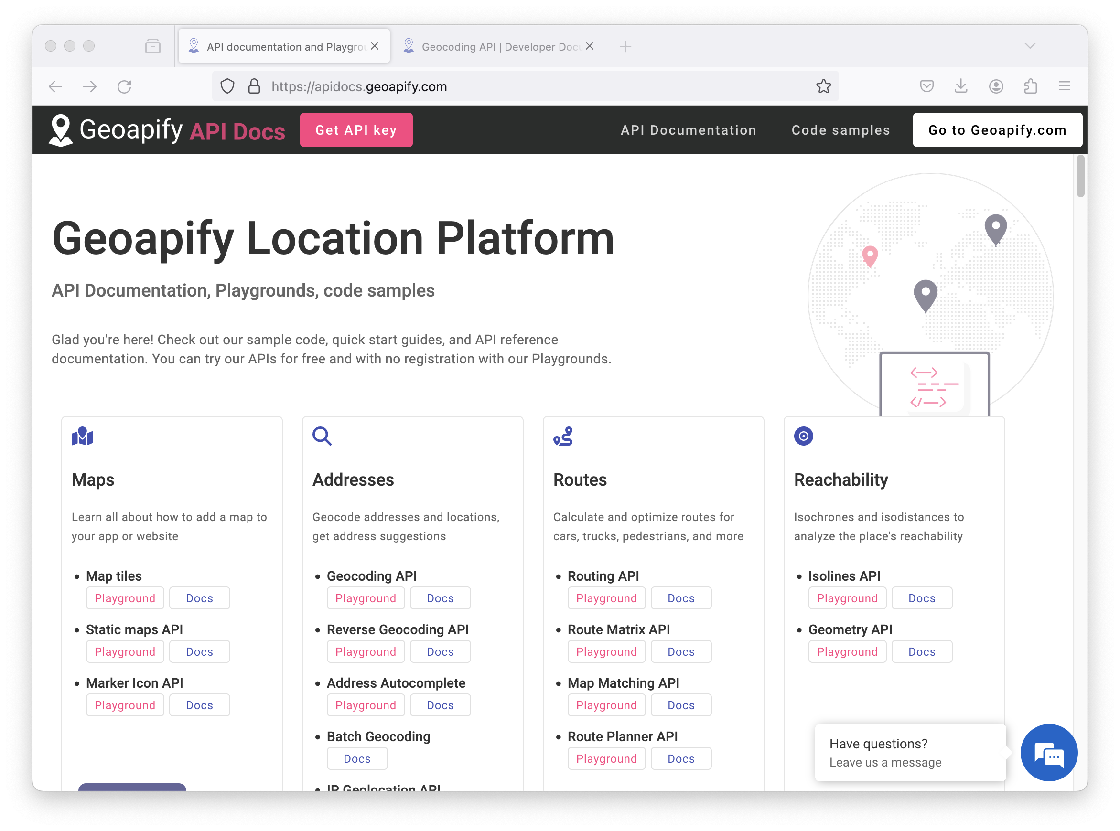
https://apidocs.geoapify.com/

Slide 42
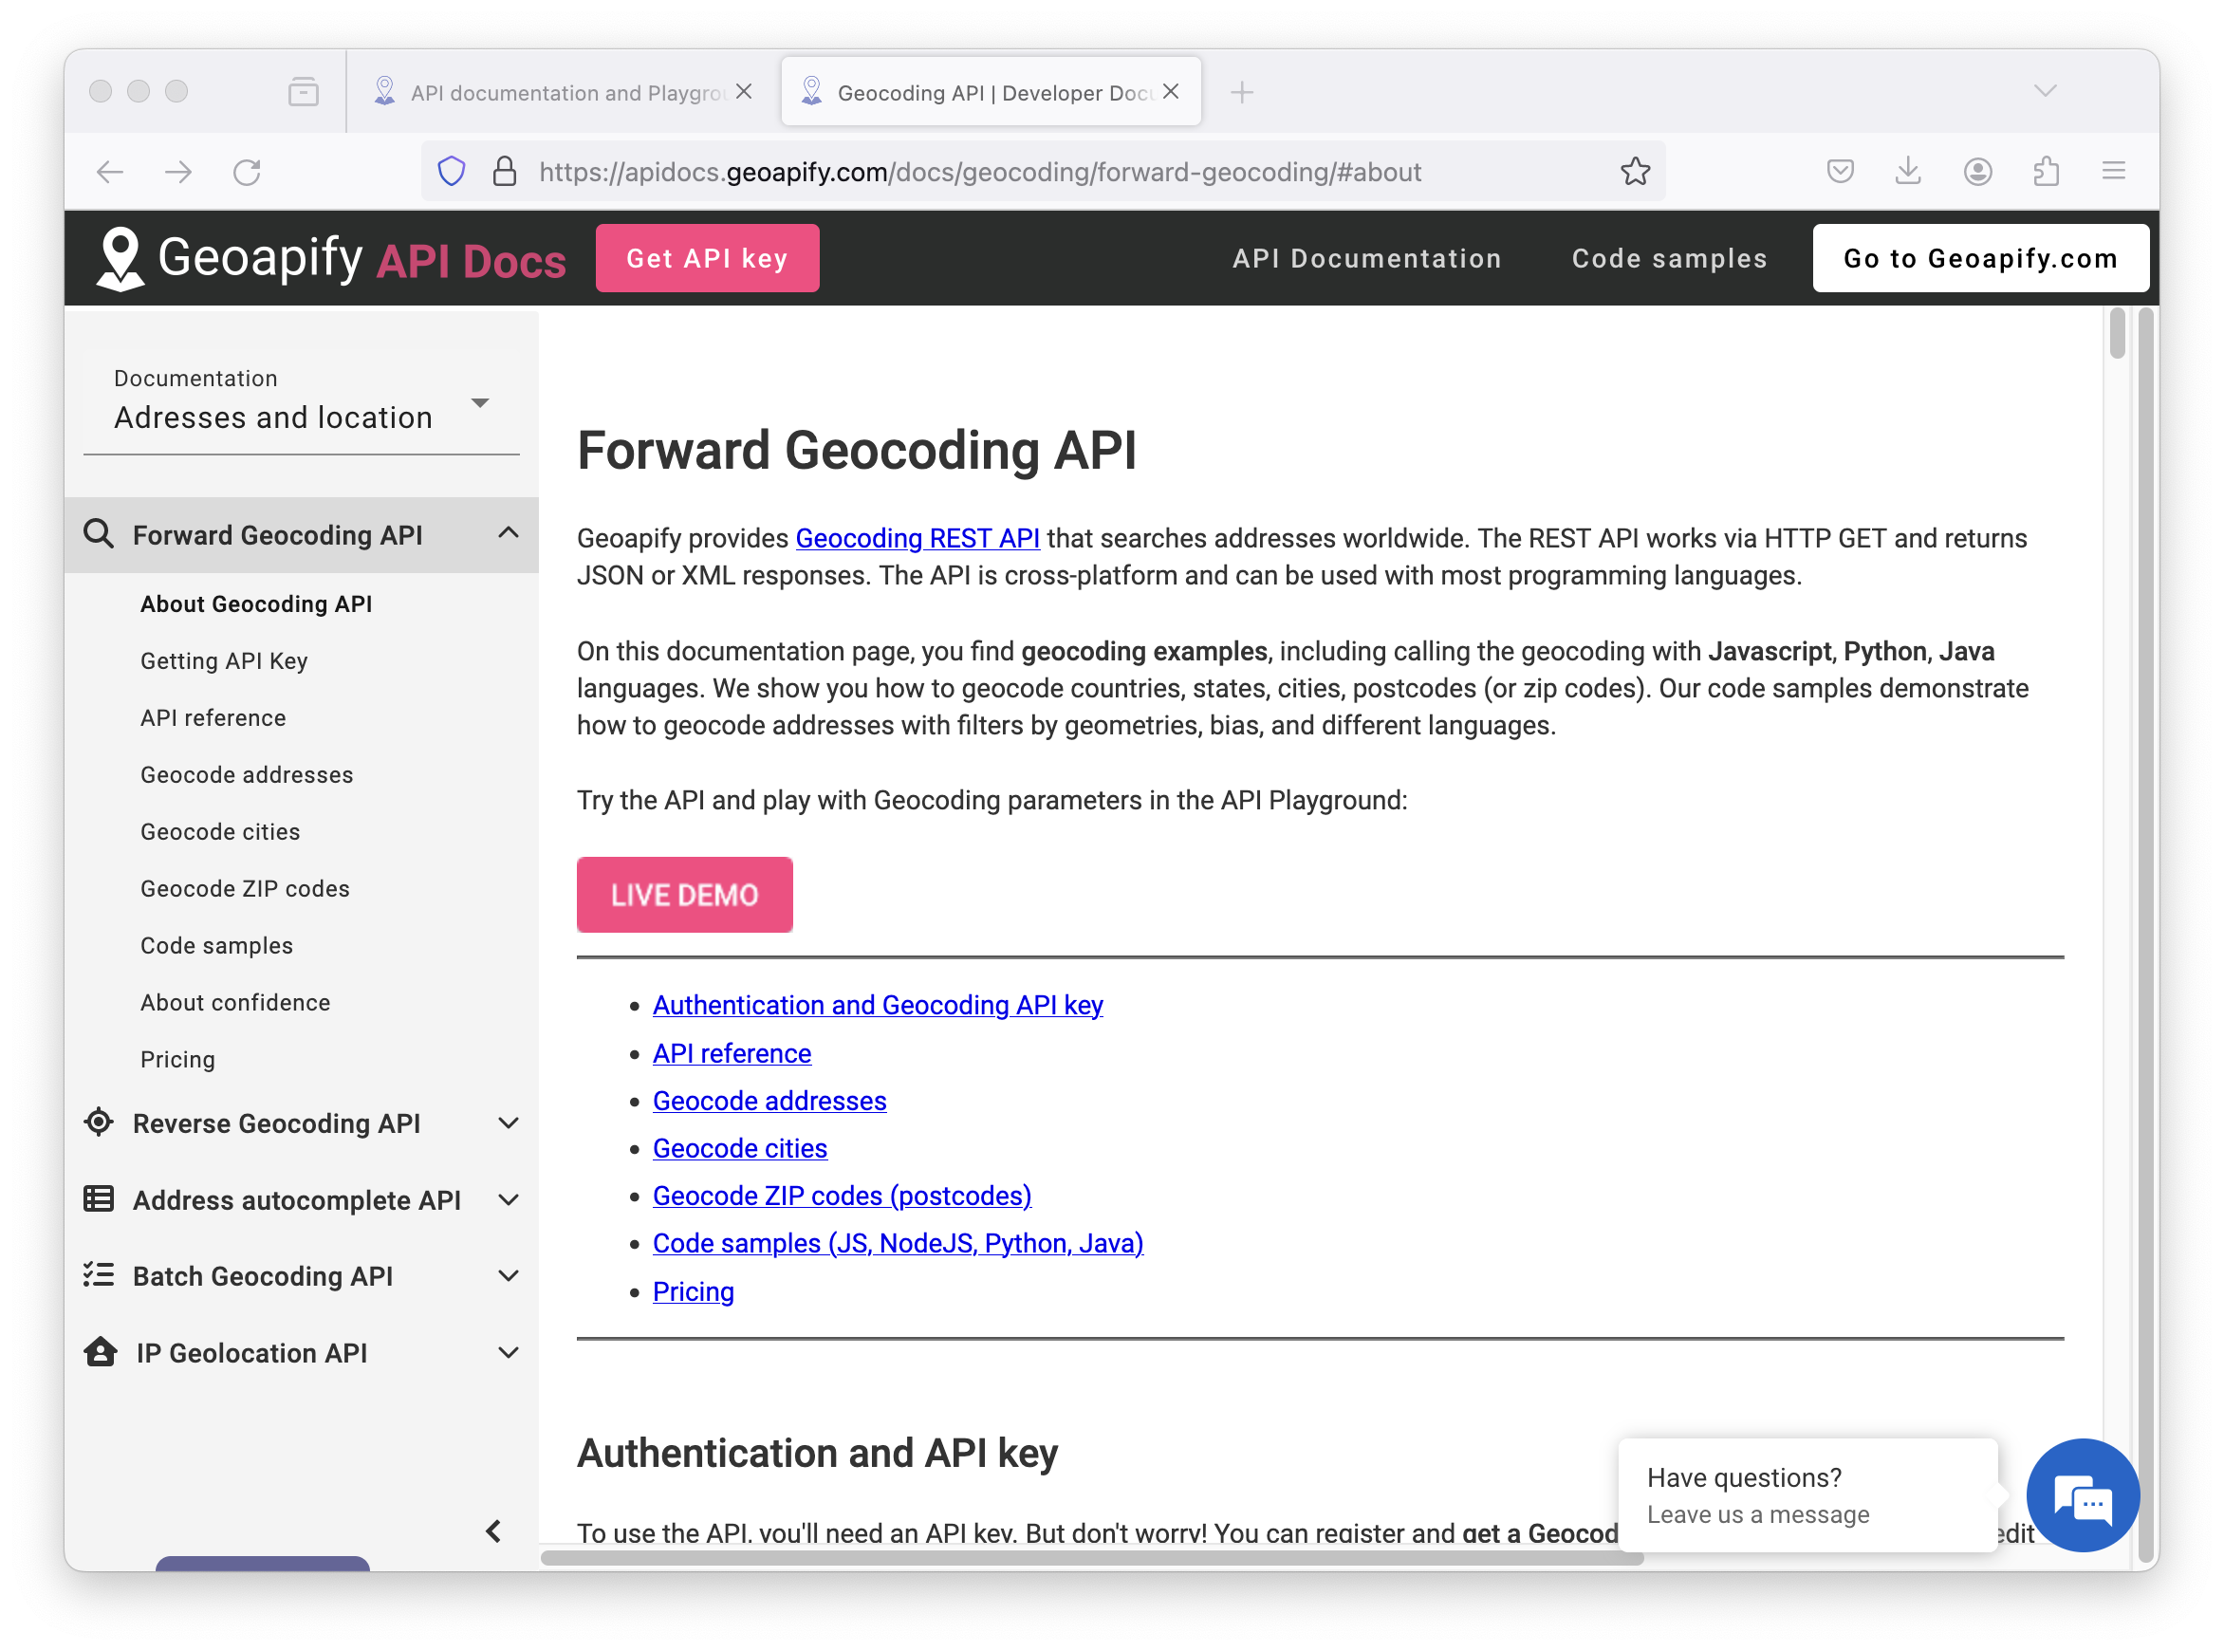
https://apidocs.geoapify.com/

Slide 43
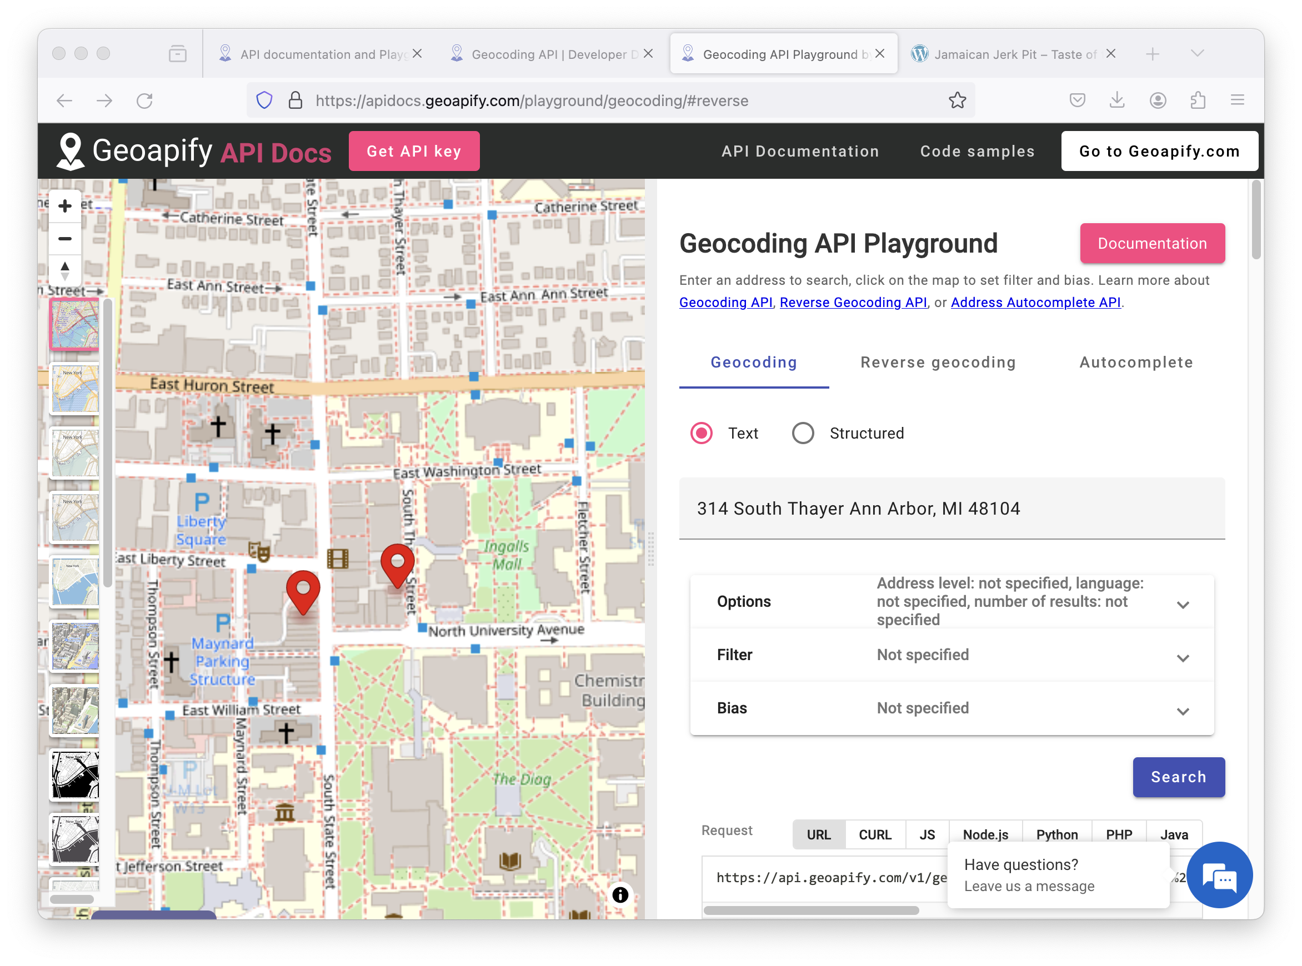
https://apidocs.geoapify.com/

Slide 44
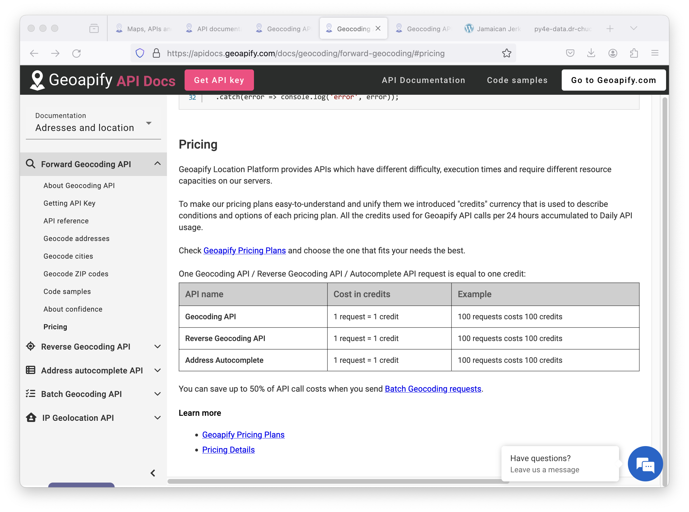
https://apidocs.geoapify.com/

Slide 45
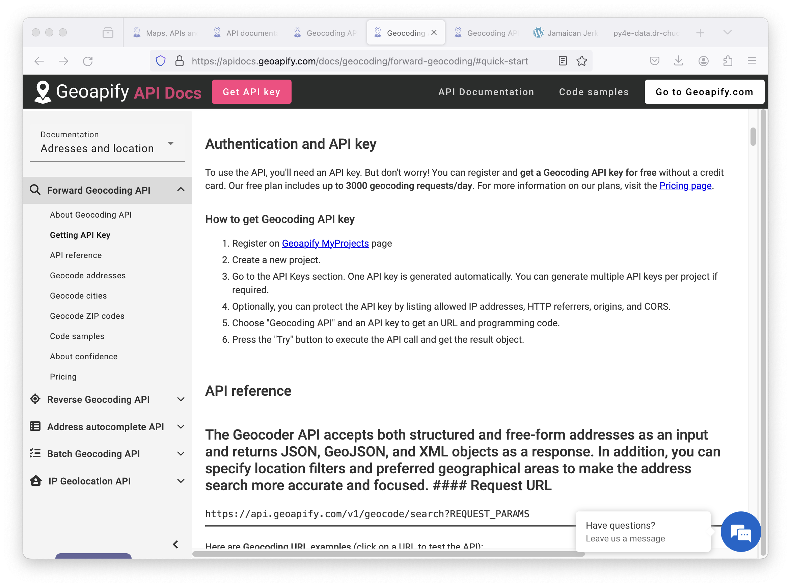
https://apidocs.geoapify.com/

Slide 46
An API Proxy
To avoid making you get an account, I have a well-hidden web server that acts as a proxy for the Geoapify data
This proxy does not require a password – but it does have rate limits and is heavily cached using an edge-caching service for performance
Your code
cloudflare
py4e-data
Geoapi

Slide 47
{
"type": "FeatureCollection",
"features": [
{
"type": "Feature",
"properties": {
"datasource": {
"sourcename": "openstreetmap",
"attribution": "© OpenStreetMap contributors",
"license": "Open Database License",
"url": "https://www.openstreetmap.org/copyright"
},
"country": "United States",
"country_code": "us",
"state": "Michigan",
"county": "Washtenaw County",
"city": "Ann Arbor",
"lon": -83.7312291,
"lat": 42.2681569,
"state_code": "MI",
"result_type": "city",
"formatted": "Ann Arbor, MI, United States of America",
http://py4e-data.dr-chuck.net/opengeo?q=Ann+Arbor%2C+MI
Note, for this course, we operate through a proxy of the geoapi data to avoid rate limitation and authentication.
opengeo.py

Slide 48
import urllib.request, urllib.parse
import http, json, ssl
serviceurl = 'https://py4e-data.dr-chuck.net/opengeo?'
while True:
address = input('Enter location: ')
if len(address) < 1: break
address = address.strip()
parms = dict()
parms['q'] = address
url = serviceurl + urllib.parse.urlencode(parms)
print('Retrieving', url)
uh = urllib.request.urlopen(url, context=ctx)
data = uh.read().decode()
print('Retrieved', len(data), 'characters', data[:20].replace('\n', ' '))
js = json.loads(data)
lat = js['features'][0]['properties']['lat']
lon = js['features'][0]['properties']['lon']
print('lat', lat, 'lon', lon)
location = js['features'][0]['properties']['formatted']
Enter location: Ann Arbor, MI
Retrieving https://py4e-data.
dr-chuck.net/opengeo?q=Ann+Arbor%2C+MI
Retrieved 1319 characters {"type":"FeatureColl
lat 42.2681569 lon -83.7312291
Ann Arbor, MI, United States of America
opengeo.py

Slide 49
Summary
Service Oriented Architecture - allows an application to be broken into parts and distributed across a network
An Application Program Interface (API) is a contract for interaction
Web Services provide infrastructure for applications cooperating (an API) over a network - SOAP and REST are two styles of web services
XML and JSON are serialization formats

Slide 50
Acknowledgements / Contributions
Thes slide are Copyright 2010- Charles R. Severance (www.dr-chuck.com) of the University of Michigan School of Information and open.umich.edu and made available under a Creative Commons Attribution 4.0 License. Please maintain this last slide in all copies of the document to comply with the attribution requirements of the license. If you make a change, feel free to add your name and organization to the list of contributors on this page as you republish the materials.
Initial Development: Charles Severance, University of Michigan School of Information
… Insert new Contributors here
...

